Slide 1
計算機概論實習
Week5(2020/10/13)
Arrays and Strings
Lab: EC 118
助教:
陳作源 russchen.cs08g@nctu.edu.tw
陳彥銨 my91015.cs08g@nctu.edu.tw
鄭智仁 king601012003.cs08g@nctu.edu.tw

Slide 2
Why Array
If you have to store 100 students’scores...
int score1=100;
int score2=90;
int score3=80;
….
int score100=70;
I wish i could do something like...
int score[100]={100, 90, 80, …, 70};

Slide 3
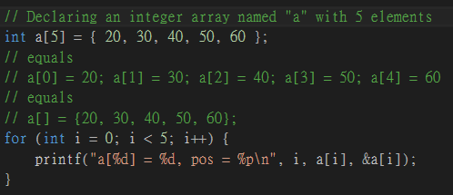

Declare a 1D Array

Slide 4


Storage of a 1D Array
The individually declared variables are stored in non-continuous space. The efficiency of operation with these data is low.
The space allocated to an array is continuous

Slide 5
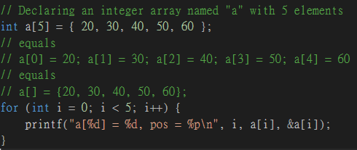

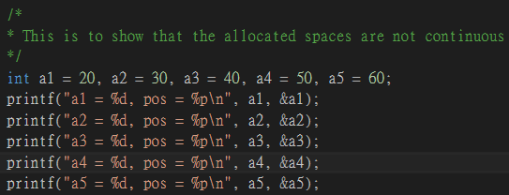

Storage of a 1D Array
How is this continuous??

Slide 6
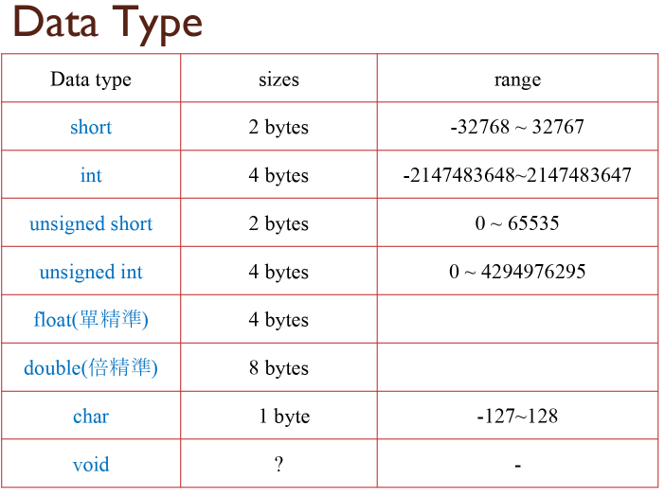
Storage of a 1D Array

Slide 7
Storage of a 1D Array
0113F9B8 | 0113F9B9 | 0113F9BA | 0113F9BB
0113F9BC | 0113F9BD | 0113F9BE | 0113F9BF
0113F9C0 | 0113F9C1 | 0113F9C2 | 0113F9C3
0113F9C4 | 0113F9C5 | 0113F9C6 | 0113F9C7
0113F9C8 | 0113F9C9 | 0113F9CA | 0113F9CB
a[0]
a[1]
a[2]
a[3]
a[4]

Slide 8
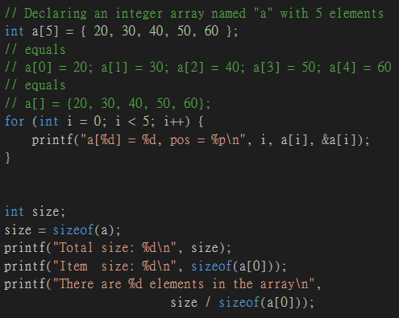
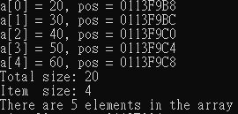
Using the sizeof Operator with Arrays
You can obtain the size of a variable with sizeof operator
Again, the unit is “byte”

Slide 9
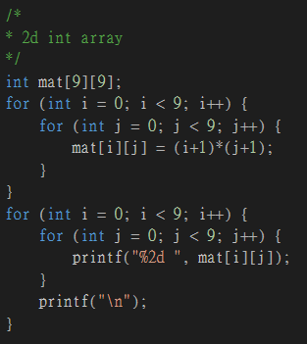
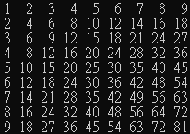
Declare a 2D Array
col
mat[0][0] =1 | mat[0][1] =2 | mat[0][2] =3 | ... | mat[0][8] =9
mat[1][0] =2 | mat[1][1] =4 | mat[1][2] =6 | ...
mat[2][0] =3 | mat[2][1] =6 | mat[2][2] =9 | ...
... | ... | ... | ...
mat[8][0] =9 |  |  |  | mat[8][8] =81
a[row][col]
row

Slide 10
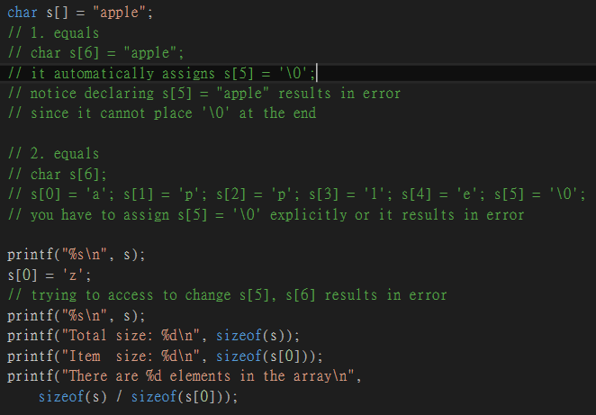

String
s[0]=’a’ | s[1]=’p’ | s[2]=’p’ | s[3]=’l’ | s[4]=’e’ | s[5]=’\0’
sizeof() does count the ‘\0’

Slide 11
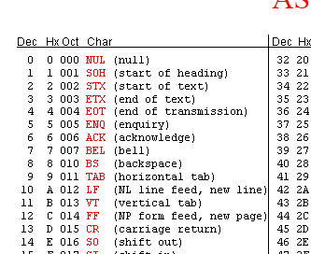
String
String is just an array of characters
'\0': terminating character
(null character)
‘c’ is not the same as ‘’c’’
‘c’ is a character and ‘’c’’ is an character array with elements ’c’ and ‘\0’

Slide 12

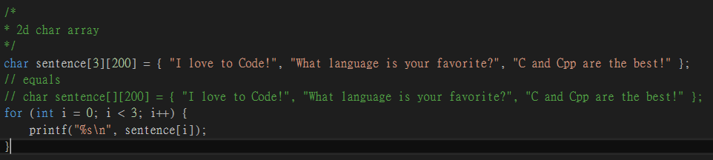
2D character array
sizeof() does count the ‘\0’
[0][0] ‘I’ | [0][1] ‘ ’ | [0][2] ‘I’ | [0][3] ‘o’ | [0][4] ‘v’ | [0][5] ‘e’ | [0][6] ‘ ’ | [0][7] ‘t’ | [0][8] ‘o’ | [0][9] ‘ ’ | [0][10] ‘c’ | [0][11] ‘o’ | [0][12] ‘d’ | [0][13] ‘e’ | [0][14] ‘!’ | [0][15] ‘\0’ | ... | [0] [199]
[1][0] ‘W’ | [1][1] ‘h’ | [1][2] ‘a’ | [1][3] ‘t’ | [1][4] ‘ ’ | [1][5] ‘l’ | [1][6] ‘a’ | [1][7] ‘n’ | [1][8] ‘g’ | [1][9] ‘u’ | [1][10] ‘a’ | [1][11] ‘g’ | [1][12] ‘e’ | [1][13] ‘ ’ | [1][14] ‘i’ | [1][15] ‘s’ | ... | [1] [199]
[2][0] ‘C’ | [2][1] ‘ ’ | [2][2] ‘a’ | [2][3] ‘n’ | [2][4] ‘d’ | [2][5] ‘ ’ | [2][6] ‘C’ | [2][7] ‘p’ | [2][8] ‘p’ | [2][9] ‘ ’ | [2][10] ‘a’ | [2][11] ‘r’ | [2][12] ‘e’ | [2][13] ‘ ’ | [2][14] ‘t’ | [2][15] ‘h’ | ... | [2] [199]

Slide 13
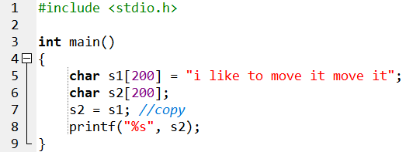
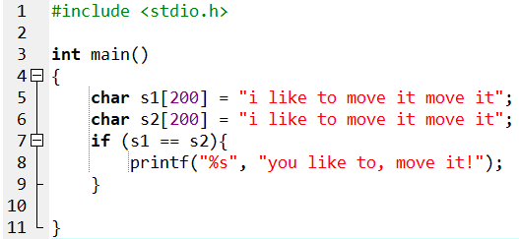

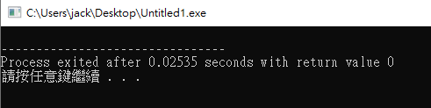

Slide 14
char s1[200] = ”i like to move it move it”
// s1 is actually the address of the start of the char array
// you cannot assign one address to another
// you can, but meaningless, to compare two address
// use <string.h>

Slide 15
string length: strlen()
size_t strlen(const char * str);
returns the length of the C string str. The length of a C string is determined by the terminating null-character (not including).
note: The size_t type is whatever type the sizeof operator returns.
C states that the sizeof operator returns an integer type, but it does not specify which integer type.
Hence, size_t can be unsigned int on one system and unsigned long on another.
[0][0] ‘I’ | [0][1] ‘ ’ | [0][2] ‘I’ | [0][3] ‘o’ | [0][4] ‘v’ | [0][5] ‘e’ | [0][6] ‘ ’ | [0][7] ‘t’ | [0][8] ‘o’ | [0][9] ‘ ’ | [0][10] ‘c’ | [0][11] ‘o’ | [0][12] ‘d’ | [0][13] ‘e’ | [0][14] ‘!’ | [0][15] ‘\0’ | ... | [0] [199]

Slide 16
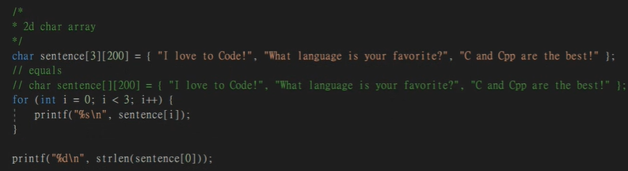

string length: strlen()
size_t strlen(const char * str);
number of words counted to ‘\0’ but not including
if something wrong with this function, check whether ‘\0’ exists
# include <string.h>
15
[0][0] ‘I’ | [0][1] ‘ ’ | [0][2] ‘I’ | [0][3] ‘o’ | [0][4] ‘v’ | [0][5] ‘e’ | [0][6] ‘ ’ | [0][7] ‘t’ | [0][8] ‘o’ | [0][9] ‘ ’ | [0][10] ‘c’ | [0][11] ‘o’ | [0][12] ‘d’ | [0][13] ‘e’ | [0][14] ‘!’ | [0][15] ‘\0’ | ... | [0] [199]

Slide 17
string copy: strcpy, strcat, strncpy
char * strcpy (char * destination, const char * source);
This function copies the string (including and ended with the ‘\0’) pointed to by source to the location pointed to by destination
char * strncpy ( char * destination, const char * source, size_t num );
The function copies the first num characters of string pointed by source to the string pointed by destination.
- If strlen(source) < num, destination is padded with ‘\0’
- If strlen(source) = num or strlen(source) > num, no ‘\0’ is copied
char * strcat ( char * destination, const char * source );
The string pointed to by source is copied to the end of the string pointed to by destination. The first character of source is copied over the null character of the destination

Slide 18
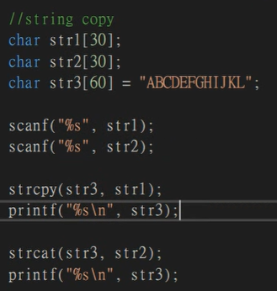

string copy: strcpy
30
str1
‘H’ | ‘e’ | ‘l’ | ‘l’ | ‘o’ | ‘\0’
str2
‘N’ | ‘C’ | ‘T’ | ‘U’ | ‘\0’
str3
‘A’ | ‘B’ | ‘C’ | ‘D’ | ‘E’ | ‘F’ | ‘G’ | ‘H’ | ‘I’ | ‘J’ | ‘K’ | ‘L’ | ‘\0’
60

Slide 19
string copy: strcpy
char * strcpy (char * destination, const char * source);
This function copies the string (including and ended with the ‘\0’) pointed to by source to the location pointed to by destination
30
str1
‘H’ | ‘e’ | ‘l’ | ‘l’ | ‘o’ | ‘\0’
str2
‘N’ | ‘C’ | ‘T’ | ‘U’ | ‘\0’
str3
‘H’ | ‘e’ | ‘l’ | ‘l’ | ‘o’ | ‘\0’ | ‘G’ | ‘H’ | ‘I’ | ‘J’ | ‘K’ | ‘L’ | ‘\0’ | ...
60

Slide 20
string copy: strcat
char * strcat ( char * destination, const char * source );
The string pointed to by source is copied to the end of the string pointed to by destination. The first character of source is copied over the null character of the destination.
30
str1
‘H’ | ‘e’ | ‘l’ | ‘l’ | ‘o’ | ‘\0’
str2
‘N’ | ‘C’ | ‘T’ | ‘U’ | ‘\0’
str3
‘H’ | ‘e’ | ‘l’ | ‘l’ | ‘o’ | ‘N’’ | ‘C’ | ‘T’ | ‘U’ | ‘\0’ | ‘K’ | ‘L’ | ‘\0’ | ...
60

Slide 21
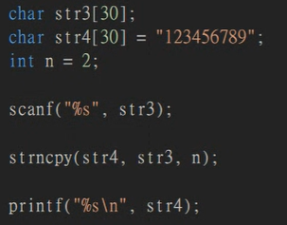

string copy: strncpy
char * strncpy ( char * destination, const char * source, size_t num );
The function copies the first num characters of string pointed by source to the string pointed by destination.
- If strlen(source) < num, destination is padded with ‘\0’
- If strlen(source) = num or strlen(source) > num, no ‘\0’ is copied
strlen(str3) = 1 < num = 2
str3
‘A’ | ‘\0’
str4
‘A’ | ‘\0’ | ‘3’ | ‘4’ | ‘5’ | ‘6’’ | ‘7’ | ‘8’ | ‘9’ | ‘\0’
30

Slide 22

string copy: strncpy
char * strncpy ( char * destination, const char * source, size_t num );
The function copies the first num characters of string pointed by source to the string pointed by destination.
- If strlen(source) < num, destination is padded with ‘\0’
- If strlen(source) = num or strlen(source) > num, no ‘\0’ is copied
strlen(str3) = 2 = num
str3
‘A’ | ‘B’ | ‘\0’
str4
‘A’ | ‘B’ | ‘3’ | ‘4’ | ‘5’ | ‘6’’ | ‘7’ | ‘8’ | ‘9’ | ‘\0’
30

Slide 23
string comparison: strcmp(), strncmp()
int strcmp ( const char * str1, const char * str2 );
This function starts comparing the first character of each string. If they are equal to each other, it continues with the following pairs until the characters differ or until a terminating null-character is reached.
int strncmp ( const char * str1, const char * str2, size_t num );
return value:
<0: the first character that does not match has a lower value in str1 than in str2
=0: the contents of both strings are equal
>0: the first character that does not match has a greater value in str1 than in str2

Slide 24
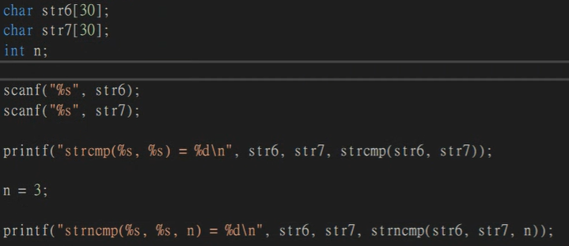

string comparison: strcmp(), strncmp()
return value:
<0: the first character that does not match has a lower value in str1 than in str2
=0: the contents of both strings are equal
>0: the first character that does not match has a greater value in str1 than in str2
think about ASCII code

Slide 25
Exercise1-pascal triangle
write a program that prints a pascal triangle with a number of layers input by user.
input: number of layer
(layer counts from 0, that is, 0 means 1 layer,
maximum number of layer input is 9, that is, 10 layers)
output: pascal triangle

Slide 26

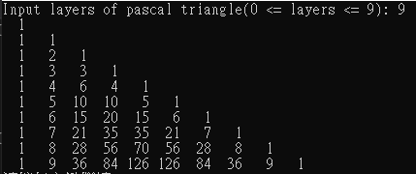

Slide 27
Exercise2-listing prime
write a program to list the prime <=80000 using two methods.
(method1-brutal)
2(P) | 3(P) | 4(P) | 5(P) | 6(P) | 7(P) | 8(P) | 9(P) | 10(P)
3%2 != 0, prime

Slide 28
Exercise2-listing prime
write a program to list the prime <=80000 using two methods.
(method1-brutal)
2(P) | 3(P) | 4(N) | 5(P) | 6(P) | 7(P) | 8(P) | 9(P) | 10(P)
4%2 == 0, 4 is not prime, break

Slide 29
Exercise2-listing prime
write a program to list the prime <=80000 using two methods.
(method1-brutal)
2(P) | 3(P) | 4(N) | 5(P) | 6(P) | 7(P) | 8(P) | 9(P) | 10(P)
5%2 != 0

Slide 30
Exercise2-listing prime
write a program to list the prime <=80000 using two methods.
(method1-brutal)
2(P) | 3(P) | 4(N) | 5(P) | 6(P) | 7(P) | 8(P) | 9(P) | 10(P)
5%3 != 0

Slide 31
Exercise2-listing prime
write a program to list the prime <=80000 using two methods.
(method1-brutal)
2(P) | 3(P) | 4(N) | 5(P) | 6(P) | 7(P) | 8(P) | 9(P) | 10(P)
5%4 != 0, 5 is prime

Slide 32
Exercise2-listing prime
write a program to list the prime <=80000 using two methods.
(method1-brutal)
This method takes:
1+2+3+...+n=O(n²)
2(P) | 3(P) | 4(N) | 5(P) | 6(N) | 7(P) | 8(P) | 9(P) | 10(P)
6%2 == 0, 6 is not prime, break

Slide 33
Exercise2-listing prime
write a program to list the prime <=80000 using two methods.
(method2-faster way)
Hint: composites of a number appear in pairs,
hence you can examine to √n and stop

Slide 34
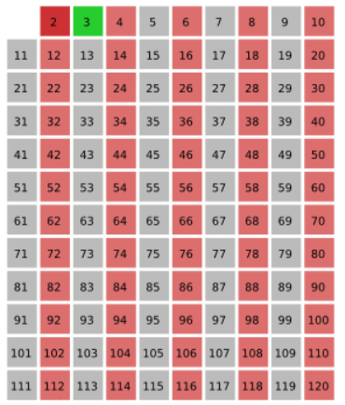
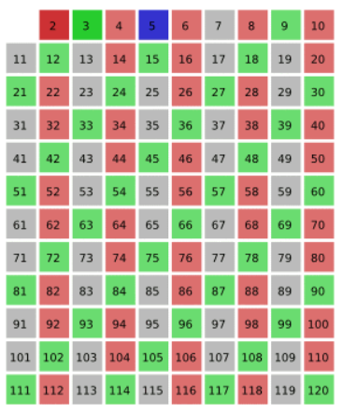
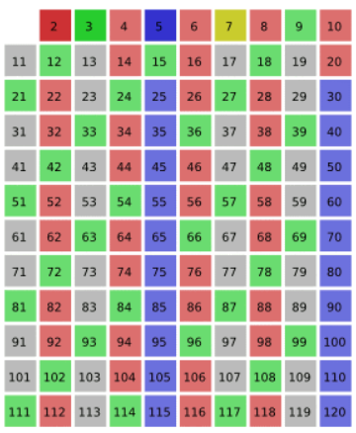
Exercise2-listing prime
write a program to list the prime <=80000 using two methods.
(method2-faster way)
https://en.wikipedia.org/wiki/Sieve_of_Eratosthenes
3
5
7

Slide 35
Exercise2-listing prime
write a program to list the prime <=80000 using two methods.
(method2-faster way)
algorithm Sieve of Eratosthenes is
input: an integer n > 1.
output: all prime numbers from 2 through n.
let A be an array of Boolean values, indexed by integers 2 to n, initially all set to true.
for i = 2, 3, 4, ..., not exceeding √n do
if A[i] is true
for j = i², i²+i, i²+2i, i²+3i, ..., not exceeding n do
A[j] := false
return all i such that A[i] is true.

Slide 36
Exercise2-listing prime
write a program to list the prime <=80000 using two methods.
implement both methods, and to see difference, add the following lines:
# include <time.h>
double START = clock(); //before any computation
// your algorithm here
double END = clock(); // after computation, before any print functions
printf("time: %lf\n", (END - START) / CLOCKS_PER_SEC);
The result of method2 should have much smaller
execution time.

Slide 37


method1
method2
...
...

